Slide 1
IT Infrastructure
Empowering Connectivity, Securing Futures

Slide 2
Index
Introduction
What is IT infrastructure?
Components of IT Infrastructure
Types of IT Infrastructure
What is IT Infrastructure Management?
Stages in IT Infrastructure Evolution.
What Is Infrastructure as a Service?
What Are the Benefits of Infrastructure as a Service?

Slide 3
Introduction
IT infrastructure serves as the foundation for digital operations within organizations.
It encompasses hardware, software, networks, data centers, and skilled personnel.
Key components include servers, networking equipment, storage devices, and end-user devices.
Software components include operating systems, middleware, and applications tailored to specific business needs.

Slide 4
Introduction
Networking infrastructure facilitates communication and data exchange between devices and systems.
Data centers provide physical space, power, and security for IT equipment.
Cloud infrastructure delivers scalable IT resources over the internet.
Skilled IT professionals are crucial for designing, deploying, and managing IT infrastructure.
IT infrastructure plays a vital role in enabling business operations, enhancing productivity, and supporting innovation.

Slide 5
What is IT infrastructure?
IT infrastructure refers to the comprehensive framework of hardware, software, networks, data centers, and personnel that collectively support and enable the operation, management, and delivery of information technology services within an organization.
IT infrastructure encompasses a wide range of components, including servers, networking equipment, storage devices, operating systems, middleware, applications, and more.

Slide 6
What is IT infrastructure?
It plays a critical role in facilitating communication, data storage and processing, application delivery, and decision-making processes within modern businesses.
IT infrastructure is essential for ensuring the reliability, scalability, security, and performance of information technology services, thereby enabling organizations to remain competitive and agile in today's digital landscape.

Slide 7
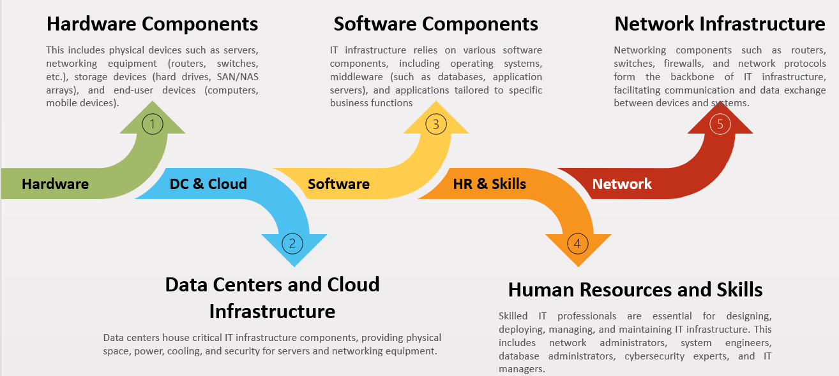
Components of IT Infrastructure

Slide 8
Types of IT infrastructure
On-Premises
Cloud Infra
Hybrid Infra
Virtual Infra

Slide 9
What’s the characteristics of a cloud DC?
Everything as a service
SLA - 99.99%
Unlimited Computation Power
Elasticity (Scalability)

